Slide 1
Communication Security for Smart Grid Distribution Networks
Elias Bou-Harb, Claude Fachkha, Makan Pourzandi, Mourad Debbabi, Chadi Assi
Presented By : Asika Islam
ID: 22273013

Slide 2
Introduction
This paper focus on the communication security aspect which deals with the distribution component of the smart grid. Author target the network security of the advanced metering infrastructure coupled with the data communication towards the transmission infrastructure. Also discuss the security and the aspects of possible communication mechanisms that could be adopted on that subpart of the grid. The correlated vulnerabilities in these systems could be remediated and associated risks may be mitigated for the purpose of enhancing the cyber security of the future electric grid.The current electrical grid is perhaps the greatest engineering achievement of the 20th century. Smart grid could be referred to as the modernization of the current electric grid for the purpose of enabling directional flows of information and electricity in order to achieve numerous goals.

Slide 3
Related work
Discussed key security technologies for a smart grid system.
Identify the fundamental challenges in data communications for the smart grid.
Elaborate on its AMI infrastructure security issues and requirements.

Slide 4
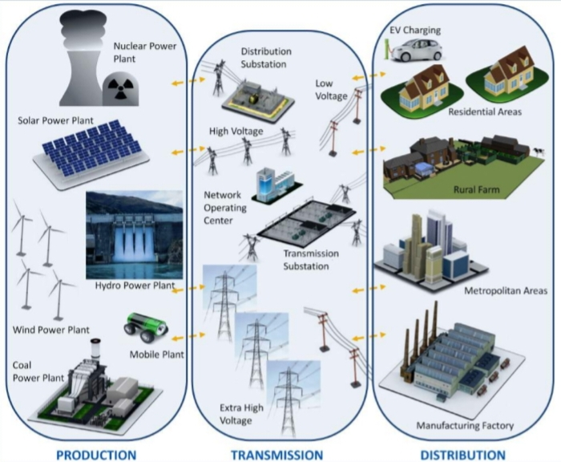
Smart grid architecture
The future electric grid has a tiered architecture to supply energy to consumers. Energy starts from power generation and flows through transmission systems to distribution and eventually to consumers. The smart grid is striving to utilize and coordinate various generation and production mechanisms.

Slide 5
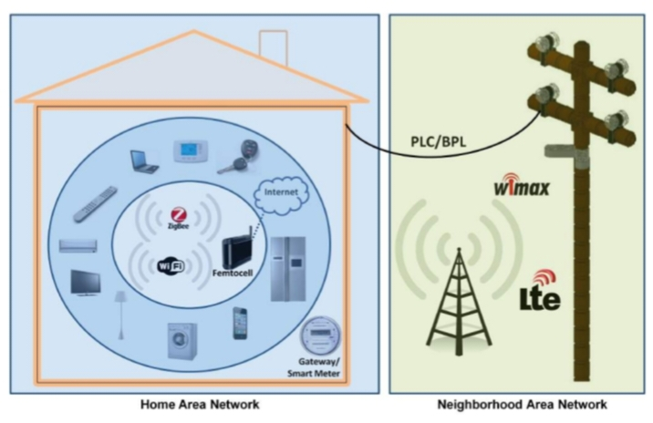
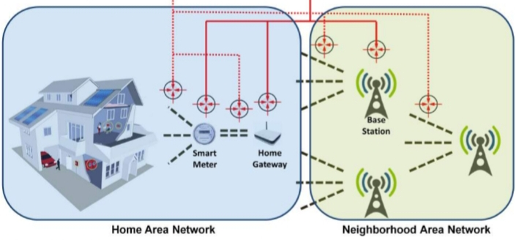
COMMUNICATION MECHANISMS
The most applicable and utilized communication mechanisms that could be adopted on that subpart of the grid by introducing technology and use in the smart grid subsequent methodology. The security objectives including confidentiality, integrity, authentication and authorization. Also elaborate on their threats and vulnerabilities.Discussed on this paper feasibility in context of their implementation and security on smart grid HANs and NANs.

Slide 6

SECURITY FRAMEWORK
The security framework that is required to enable the discussed communication techniques to be employed for smart grid applications should be based on Device authentication, Data confidentiality, Message integrity, Prevent potential cyber attacks and Facilitating communication overhead.

Slide 7
CONCLUSION
The author investigated applicable communication mechanisms that could be adopted on smart grid distribution networks. For security objectives and threats used cyber security infrastructures. Practical feasibility in terms of technical implementation, possible obstacles, and core security issues and attacks on smart grid HANs and NANs. The cyber security of the future electric grid and hence accomplishing consumers utmost trust in such a major gird transformation.

Slide 8
Thank You
Notes:
8

